Slide 1


<Zach>
<9/2/23>

Slide 2

Outline
Executive Summary
Introduction
Methodology
Results
Conclusion
Appendix

Slide 3
Executive Summary
Summary of methodologies
Data collection
Data wrangling
Exploratory Data Analysis with Data Visualization
Exploratory Data Analysis with SQL
Building an interactive map with Folium
Building a Dashboard with Plotly Dash
Predictive analysis (Classification)
Summary of all results
Exploratory Data Analysis results
Interactive analytics demo in screenshots
Predictive analysis results

Slide 4
Introduction
Project Background and Context: SpaceX, a leading player in the commercial space industry, has revolutionized space travel by significantly reducing costs. They advertise Falcon 9 rocket launches at $62 million, in contrast to other providers charging over $165 million per launch. Much of this cost reduction is attributed to SpaceX's ability to reuse the first stage of their rockets. Therefore, accurately predicting whether the first stage will successfully land is crucial for estimating launch costs. Leveraging publicly available data and machine learning models, our objective is to forecast whether SpaceX will reuse the first stage.
Key Research Questions:
Impact of Variables: We aim to investigate how variables such as payload mass, launch site, number of flights, and orbits influence the success of the first stage landing.
Temporal Trends: We seek to understand if the rate of successful landings has shown an upward trend over the years, reflecting improvements in SpaceX's technology and operations.
Algorithm Selection: Our research will identify the most effective algorithm for binary classification in this specific case, ensuring accurate predictions regarding first stage reusability.
By addressing these research questions, we aim to provide valuable insights into SpaceX's first stage reuse and contribute to the understanding of factors that impact successful landings.

Slide 5

Section 1

Slide 6
Methodology
Executive Summary
Data collection methodology:
Using SpaceX Rest API
Using Web Scrapping from Wikipedia
Perform data wrangling
Filtering the data
Dealing with missing values
Using One Hot Encoding to prepare the data to a binary classification
Perform exploratory data analysis (EDA) using visualization and SQL
Perform interactive visual analytics using Folium and Plotly Dash
Perform predictive analysis using classification models
How to build, tune, evaluate classification models

Slide 7
Data Collection
The data collection process involved a dual approach. We utilized SpaceX's REST API for certain data columns, including FlightNumber, Date, BoosterVersion, PayloadMass, Orbit, LaunchSite, Outcome, Flights, GridFins, Reused, Legs, LandingPad, Block, ReusedCount, Serial, Longitude, and Latitude. Additionally, we performed web scraping on SpaceX's Wikipedia entry to extract data columns such as Flight No., Launch site, Payload, PayloadMass, Orbit, Customer, Launch outcome, Version Booster, Booster landing, Date, and Time. This combined methodology enabled us to gather comprehensive information on launches, facilitating a more in-depth analysis.

Slide 8
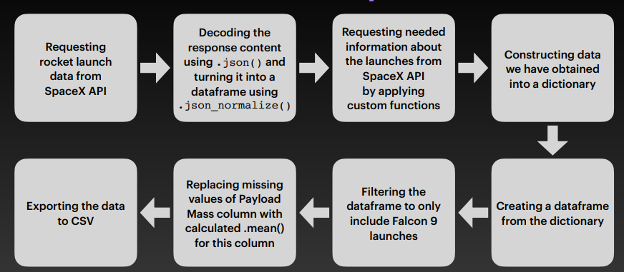
Data Collection – SpaceX API
https://github.com/ZichenLiu123/DataCapstone.git

Slide 9
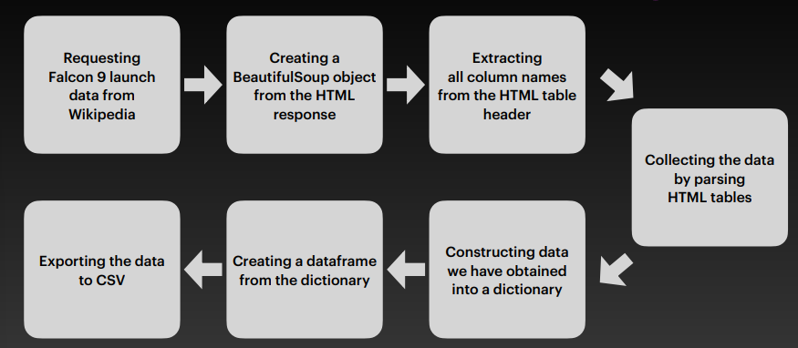
Data Collection - Scraping
https://github.com/ZichenLiu123/DataCapstone.git

Slide 10
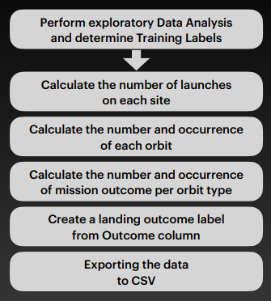
Data Wrangling
In the dataset, we track booster landings with the following labels:
True Ocean: Successful ocean landing.
False Ocean: Unsuccessful ocean landing.
True RTLS: Successful ground pad landing.
False RTLS: Unsuccessful ground pad landing.
True ASDS: Successful drone ship landing.
False ASDS: Unsuccessful drone ship landing.
We simplify these outcomes as:
"1": Successful landing.
"0": Unsuccessful landing.

Slide 11
EDA with Data Visualization
We've generated several informative charts:
Flight Number vs. Payload Mass
Flight Number vs. Launch Site
Payload Mass vs. Launch Site
Orbit Type vs. Success Rate
Flight Number vs. Orbit Type
Payload Mass vs. Orbit Type
Success Rate Yearly Trend
These scatter plots illustrate potential relationships between variables, which could be harnessed in machine learning models for predictive analysis.
Additionally, we've included bar charts to facilitate comparisons between discrete categories. These charts highlight the connections between specific categories being compared and the corresponding measured values.
Moreover, our line charts present data trends over time, serving as valuable tools for analyzing time-series data.

Slide 12
EDA with SQL
We've executed a series of SQL queries to extract valuable insights from the space mission data:
Unique Launch Sites: We've displayed the names of the unique launch sites involved in space missions.
Launch Sites Starting with 'CCA': We've retrieved 5 records where launch sites begin with the string 'CCA.'
Total Payload Mass by NASA (CRS): The total payload mass carried by boosters launched by NASA (CRS) has been calculated.
Average Payload Mass for Booster Version F9 v1.1: We've computed the average payload mass carried by boosters of version F9 v1.1.
First Successful Ground Pad Landing Date: The date of the first successful landing outcome on a ground pad has been identified.
Boosters with Successful Drone Ship Landings (Payload 4000-6000): We've listed the names of boosters that achieved success in drone ship landings with payload masses greater than 4000 but less than 6000.
Total Successful and Failed Mission Outcomes: We've provided a count of both successful and failed mission outcomes.
Max Payload Carrying Booster Versions: The names of booster versions that carried the maximum payload mass have been listed.
Failed Drone Ship Landings in 2015: We've listed the failed landing outcomes on drone ships, along with their booster versions and launch site names, for the months in the year 2015.
Ranking Landing Outcomes (2010-06-04 to 2017-03-20): We've ranked the count of landing outcomes (e.g., Failure on drone ship or Success on ground pad) between June 4, 2010, and March 20, 2017, in descending order.
These queries provide valuable insights and help analyze various aspects of space mission data.

Slide 13
Build an Interactive Map with Folium
We've enhanced the visualization of launch sites and their associated data as follows:
Markers of All Launch Sites:
We've incorporated markers with circles, popup labels, and text labels for the NASA Johnson Space Center, utilizing its latitude and longitude coordinates as the starting point.
Additionally, markers with circles, popup labels, and text labels have been added for all launch sites. These markers display the geographical locations of the launch sites and their proximity to the Equator and coastlines.
Colored Markers for Launch Outcomes:
To provide clarity regarding launch outcomes, we've included colored markers. Successful launches are represented in green, while failed launches are marked in red. We've utilized Marker Cluster to identify launch sites with relatively high success rates.
Distances between Launch Sites and Proximities:
For improved spatial understanding, we've introduced colored lines that illustrate distances between the KSC LC-39A launch site (as an example) and its nearby features, such as railways, highways, coastlines, and the closest city.
These enhancements enhance the visual representation of launch site data, making it easier to discern launch outcomes and spatial relationships.

Slide 14
Build a Dashboard with Plotly Dash
Launch Sites Dropdown List:
We've introduced a user-friendly dropdown list that allows users to easily select their desired launch site.
Pie Chart for Success Launches:
To provide at-a-glance insights, we've incorporated a dynamic pie chart. It displays the total count of successful launches for all sites. If a specific launch site is chosen from the dropdown, the chart also shows the success-to-failure ratio for that site.
Payload Mass Range Slider:
For precise data filtering, we've included a slider that allows users to define the payload mass range they wish to explore.
Scatter Chart for Payload Mass vs. Success Rate:
We've integrated a scatter chart that visually represents the relationship between payload mass and launch success. This chart offers a clear view of how these variables correlate.

Slide 15
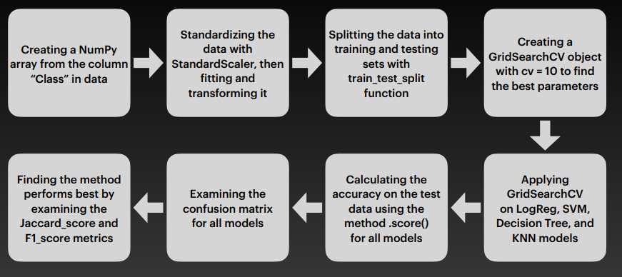
Predictive Analysis (Classification)

Slide 16
Results
Exploratory data analysis results
Interactive analytics demo in screenshots
Predictive analysis results

Slide 17

Section 2

Slide 18
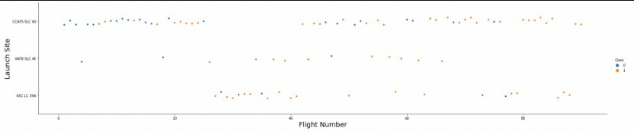
Flight Number vs. Launch Site
Insights:
Temporal Trend: Initially, the earliest flights experienced a string of failures, while the latest flights have consistently achieved success. This temporal pattern suggests an improvement in mission outcomes over time.
Launch Site Significance: The CCAFS SLC 40 launch site stands out, accounting for approximately half of all launches. This launch site plays a central role in the mission portfolio.
High Success Rates: Notably, VAFB SLC 4E and KSC LC 39A exhibit higher success rates compared to other sites. This implies that these launch sites have a track record of successful missions.
Assumption of Success Improvement: There is an observable trend where each new launch tends to have a higher rate of success. This suggests that as the space program progresses, lessons learned and technological advancements contribute to increased mission success.

Slide 19
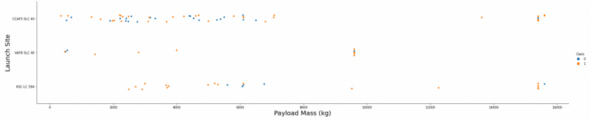
Payload vs. Launch Site
Analysis:
Payload Mass and Success Correlation: Across all launch sites, a consistent trend emerges - the higher the payload mass, the greater the success rate. This indicates a positive correlation between payload mass and mission success. Launching heavier payloads tends to result in more successful missions.
Success with Heavier Payloads: Notably, a significant proportion of launches with payload masses exceeding 7000 kg have achieved success. This suggests that the launch program has demonstrated the capability to handle and deliver heavier payloads effectively.
KSC LC 39A's Remarkable Success: KSC LC 39A stands out with a remarkable achievement. It boasts a 100% success rate for payloads weighing less than 5500 kg. This launch site has consistently delivered successful missions, especially for payloads within this specific weight range.

Slide 20
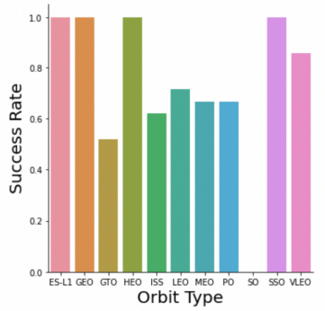
Success Rate vs. Orbit Type
Insights:
Orbits with Perfect Success (100%): Several orbits have maintained a flawless record with a 100% success rate. These orbits include ES-L1, GEO (Geosynchronous Earth Orbit), HEO (Highly Elliptical Orbit), and SSO (Sun-Synchronous Orbit). The consistent success in these orbits highlights the reliability and precision of missions in these specific orbital trajectories.
Orbit with Zero Success (0%): On the other hand, the SO (Sub-Orbital) orbit stands in stark contrast with a 0% success rate. This suggests that missions aiming for sub-orbital trajectories have faced challenges and have not achieved successful outcomes.
Orbits with Varied Success (50%-85%): Several other orbits fall within a success rate range of 50% to 85%. These orbits include GTO (Geostationary Transfer Orbit), ISS (International Space Station), LEO (Low Earth Orbit), MEO (Medium Earth Orbit), and PO (Polar Orbit). The variability in success rates in these orbits indicates that mission outcomes in these orbital paths are influenced by various factors and may require further analysis and improvements.

Slide 21
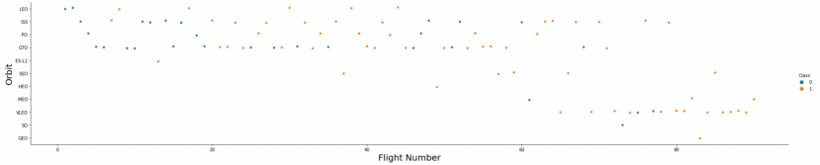
Flight Number vs. Orbit Type
Analysis:
LEO Orbit and Flight Number: In the Low Earth Orbit (LEO), there appears to be a notable relationship between mission success and the number of flights. Specifically, as the number of flights increases, the likelihood of success in LEO orbits also tends to increase. This suggests that experience and accumulated knowledge from previous LEO missions contribute to improved success rates in this orbital trajectory.
GTO Orbit and Flight Number: In contrast, the Geostationary Transfer Orbit (GTO) does not display a significant relationship between flight number and mission success. This implies that factors other than the number of flights play a more dominant role in determining the success of missions in GTO orbits. Further investigation may be needed to identify these influential factors and optimize mission outcomes in GTO trajectories.

Slide 22
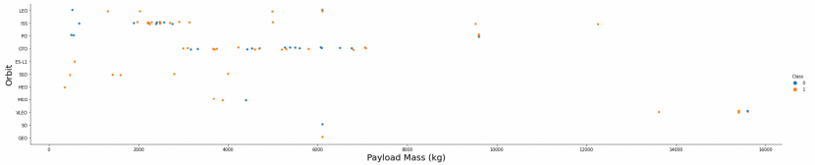
Payload vs. Orbit Type
Analysis:
Impact of Heavy Payloads on GTO Orbits: For missions in Geostationary Transfer Orbit (GTO), heavy payloads seem to have a negative influence on mission success. This suggests that the challenges associated with launching heavy payloads to GTO orbits may result in a lower success rate. Factors such as the need for increased propulsion and precise orbital maneuvers could contribute to this negative influence.
Positive Impact of Heavy Payloads on GTO and Polar LEO (ISS) Orbits: In contrast, heavy payloads appear to have a positive influence on missions in both GTO and Polar Low Earth Orbit (LEO) trajectories, such as those heading to the International Space Station (ISS). This implies that when launching heavier payloads to these orbits, the success rate tends to be higher. This could be attributed to the robustness of the launch system and payload handling capabilities, making it more suitable for missions with heavier payloads in these specific orbital paths.

Slide 23
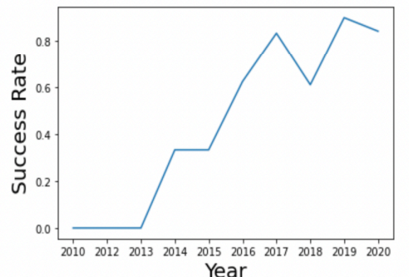
Launch Success Yearly Trend
Since 2013, the success rate has consistently risen until 2020.

Slide 24
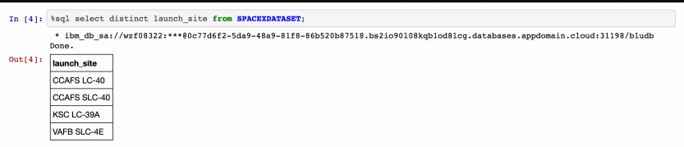
All Launch Site Names

Slide 25
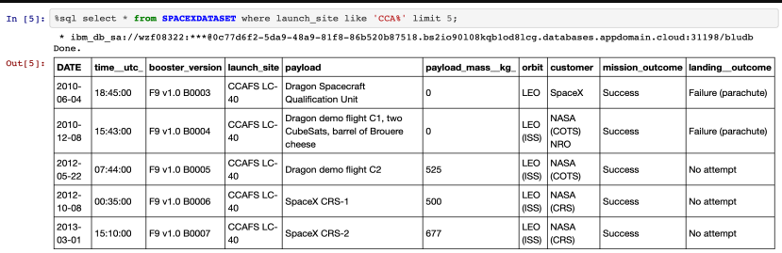
Launch Site Names Begin with 'CCA'
5 records with starting string of ‘CCA’

Slide 26
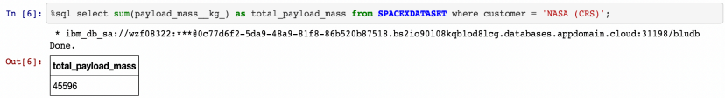
Total Payload Mass
Total payload mass carried by boosters

Slide 27
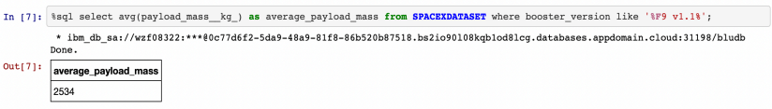
Average Payload Mass by F9 v1.1

Slide 28
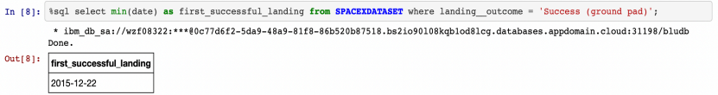
First Successful Ground Landing Date

Slide 29
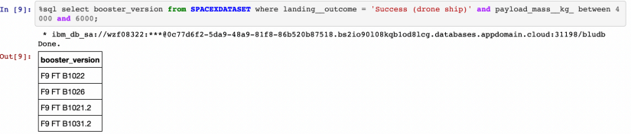
Successful Drone Ship Landing with Payload between 4000 and 6000

Slide 30
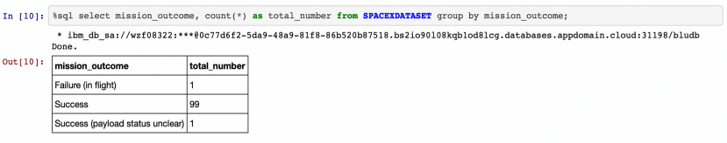
Total Number of Successful and Failure Mission Outcomes

Slide 31
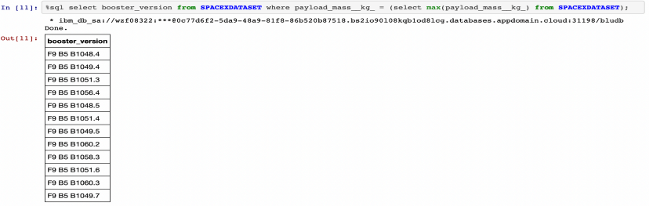
Boosters Carried Maximum Payload

Slide 32
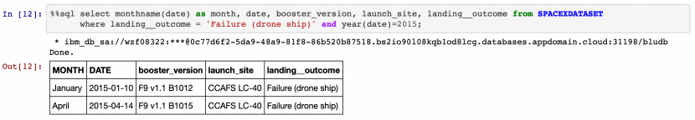
2015 Launch Records

Slide 33
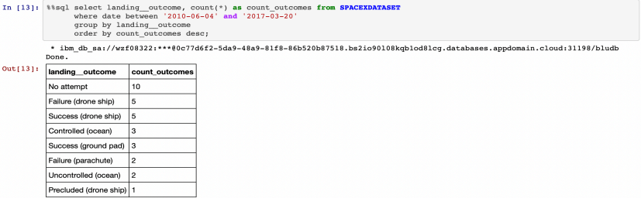
Rank Landing Outcomes Between 2010-06-04 and 2017-03-20

Slide 34

Section 3

Slide 35
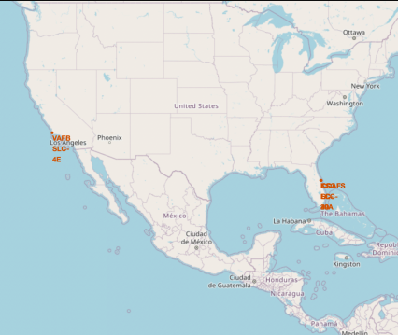
Launch site locations
Analysis:
Proximity to Equator and Launch Speed: Most launch sites are strategically located near the Equator line, where the Earth's surface is moving at an astonishing speed of approximately 1670 km/hour due to its rotation. Objects at the Equator are already moving at this tremendous velocity. When a spacecraft is launched from the Equator, it inherits this initial velocity, thanks to the principle of inertia. This boost in speed aids the spacecraft in achieving and maintaining the necessary velocity to remain in orbit. The Equator's unique characteristics make it an ideal location for space launches.
Coastal Location and Safety: Additionally, all launch sites are situated in close proximity to coastlines. This choice of location minimizes the risk associated with launching rockets over land. By directing rocket launches toward the ocean, the space program mitigates the potential danger of falling debris or explosions occurring near populated areas. This safety measure prioritizes the protection of human lives and property.

Slide 36
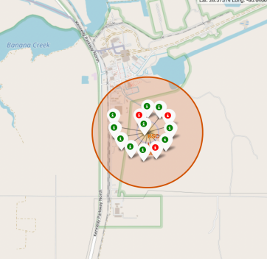
Launch records
Analysis:
Marker Color Codes for Success: The color-coded markers provide a straightforward visual cue for identifying launch sites with varying success rates. Specifically:
Green markers represent successful launches.
Red markers indicate failed launches.
High Success Rate at KSC LC-39A: Notably, the launch site KSC LC-39A stands out with a significantly high success rate, as indicated by a predominance of green markers. This suggests that KSC LC-39A has a remarkable track record of successful launches, making it a noteworthy and reliable site for space missions.

Slide 37
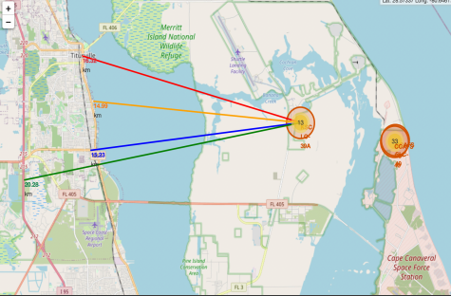
Distance from launch site to proximities
Analysis:
The visual analysis of launch site KSC LC-39A reveals its proximity to various critical elements:
Railway, Highway, and Coastline Proximity: KSC LC-39A is relatively close to a railway (15.23 km), a highway (20.28 km), and the coastline (14.99 km). This proximity suggests convenient transportation links and accessibility for mission logistics.
Closest City, Titusville: The launch site is also in close proximity to its nearest city, Titusville, at a distance of 16.32 km. This location facilitates logistical support and access to resources for space missions.
Safety Considerations: It's essential to consider the safety aspect when launching rockets, especially if they experience failures. Failed rockets, moving at high speeds, can cover distances of 15-20 km in mere seconds. Therefore, launching near populated areas could pose a potential danger. The choice of launch site in proximity to transportation infrastructure and away from densely populated areas helps mitigate risks and ensures the safety of nearby communities.

Slide 38

Section 4

Slide 39
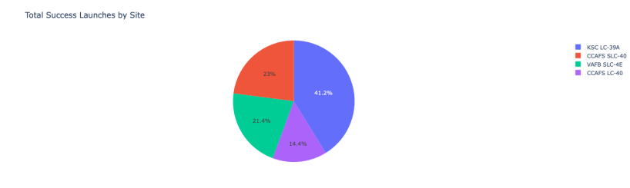
Success rate for sites

Slide 40
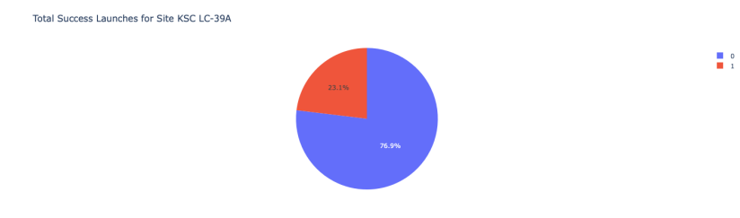
Highest launch success

Slide 41
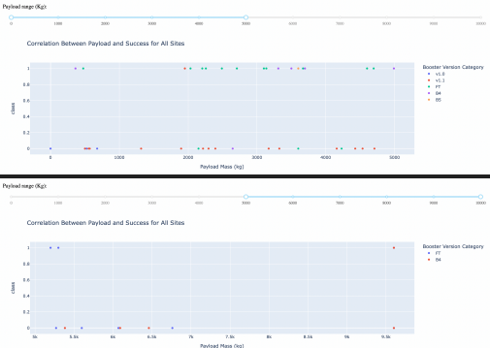
Payload mass vs Launch Outcome

Slide 42

Section 5

Slide 43
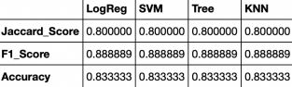
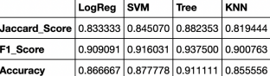
Classification Accuracy
Analysis:
Initial Test Set Scores: Upon reviewing the scores from the test set, it's evident that we cannot definitively determine which method performs best. The test set, with its limited size of 18 samples, may not provide sufficient statistical power to draw conclusive results.
Consideration of Full Dataset: To address this limitation, we extended our evaluation to encompass the entire dataset. This comprehensive analysis involving the entire dataset reveals more reliable insights.
Decision Tree Model Superiority: Notably, when evaluating all methods based on the complete dataset, the Decision Tree Model emerges as the standout performer. This model not only achieves higher scores but also boasts the highest accuracy among all methods tested.
The decision tree model's superior performance on the full dataset underscores its effectiveness and suggests its suitability for the task at hand. It outperforms other methods in terms of accuracy and overall predictive capability.
Scores and accuracy of test set
Scores and accuracy of entire set

Slide 44
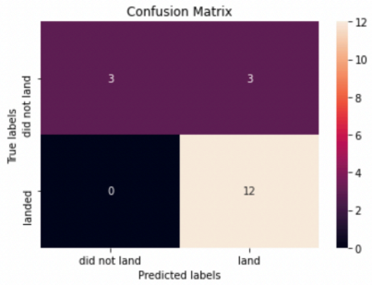
Confusion Matrix
Analysis:
Upon examining the confusion matrix, it becomes apparent that the logistic regression model is effective at distinguishing between various classes or categories. However, one notable challenge stands out.
The primary issue highlighted by the confusion matrix is the occurrence of false positives. In the context of classification models, a false positive occurs when the model incorrectly predicts a positive outcome when the actual outcome is negative. This suggests that the model tends to generate more positive predictions than are actually true.
Addressing this issue of false positives is crucial, as it can lead to inaccurate results or decisions, particularly in applications where precision and reliability are paramount. Further optimization or fine-tuning of the model may be required to reduce the rate of false positives and improve its overall performance.

Slide 45
Conclusions
Decision Tree Model Superiority: The Decision Tree Model stands out as the most effective algorithm for this dataset, demonstrating its suitability for the task.
Payload Mass Impact: Launches with lower payload masses tend to exhibit better success rates compared to launches with larger payload masses.
Proximity to Equator and Coast: The majority of launch sites are located near the Equator line, taking advantage of the Earth's rotational speed. Additionally, all launch sites are strategically positioned in very close proximity to coastlines to minimize the risk of debris falling near populated areas.
Temporal Success Increase: Over the years, there is a consistent and positive trend in the success rate of launches, reflecting continuous improvements in mission outcomes.
KSC LC-39A's High Success Rate: Among all launch sites, KSC LC-39A boasts the highest success rate, making it a reliable choice for space missions.
Perfect Success Orbits: Orbits ES-L1, GEO, HEO, and SSO maintain a perfect 100% success rate, indicating their reliability for mission success.

Slide 46

Thanks to @evgenyzorin for some of the visuals

